Slide 1
Lectures 7 and 8 (I think) Coalescence and Ancestral Recombination Graphs Inference of demographic histories of natural populations using sequence data
Richard Durbin

Slide 2
Exercise
What can we say about the time to the most recent common ancestor from which any pair of the MPhil students from the class of 2017-18 share inherited DNA?
What theory would you use to estimate this time, and what parameters are required? Suggest some values for these parameters.
What additional factors might modify this estimate? Estimate how they would affect it and by how much.
Can you come up with an estimate and range?

Slide 3
References/Books
Gene genealogies and the coalescent process
Hudson RR (1990) Oxford Surveys in Evolutionary Biology 7:1-44 Excellent review and ms simulator
Approximating the coalescent with recombination
McVean GA, Cardin NJ (2005) Phil Trans Roy Soc 1459:1387-1393 Sequentially Markovian Coalescent
Coalescent Theory – an Introduction
John Wakeley (2008) Strong but heavy
Gene Genealogies, Variation and Evolution: A Primer in Coalescent Theory
Jotun Hein, Mikkel Schierrup, Carsten Wiuf (2005) More quirky; lots of nice, but stray observations

Slide 4
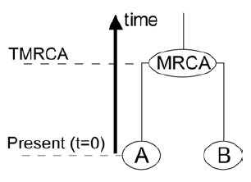
Tree on two sequences
Gustave Malécot (1940s)
Coalescence is joining together, in our case going backwards in time
Chance of coalescence per generation is 1/N
TMRCA is exponentially distributed with mean N

Slide 5
Probability of observing a mutation
To see a mutation, it must have happened on one of the branches since the common ancestor
P(observed mutation) = 2Tμ
E(observed difference rate) = θ_{π} = 2Nμ
Humans are diploid, so θ_{π} = 4N_{e}μ, where N_{e}is the effective population size
For humans, θ_{π} =~ 0.001
1/800 – 1/1200 depending on population
Hard to measure N_{e} and μ independently…

Slide 6
Adding another sequence
Chance of coalescence per
generation from three
sequences is 3/N
Once we have a coalescence we are back to the situation with two sequences
From i sequences chance is i(i-1)/2N

Slide 7
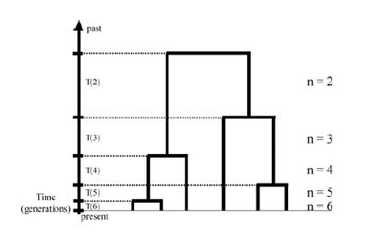
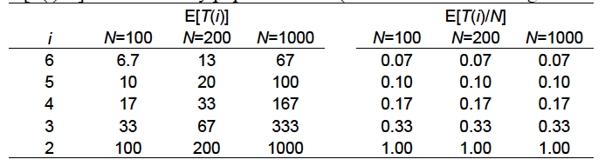
Coalescent model (Kingman, 1980) A distribution on trees
T(i) ~ exponential with mean 2N/i(i-1)
If we scale by 1/N then the shape is independent of N.
So can take N=1 for general dbn.

Slide 8
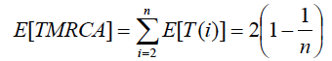
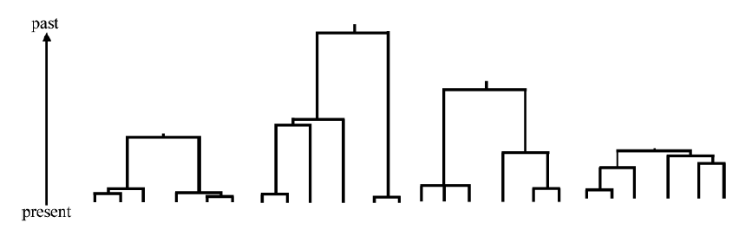
Properties of the coalescent
As we add extra sequences, they are increasingly likely to coalesce very fast, and increasingly unlikely to affect the full TMRCA
Trees are very variable
E.g. 4 samples
on 6 leaves

Slide 9
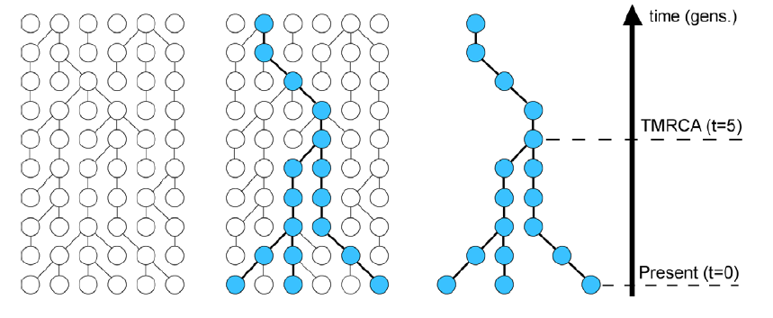
Relationship between forwards in time (Wright-Fisher) and backwards in time (Coalescent) models
Population evolution
forwards
Coalescent tree
backwards
The coalescent tree describes a sample from the forward process. Kingman coalescent generates an asymptotically “exact” sample from Wright-Fisher model.

Slide 10
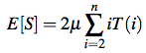
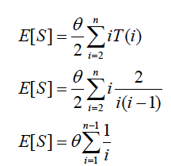
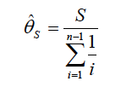
Genetic variation in a sample
Mutations occur at random on the tree
Separation of sources of randomness
Random genealogy = tree structure from coalescent
Random sampling of mutations on the tree
Let S be the number of mutations = segregating sites
Watterson’s theta
E(S) ~ θ log n

Slide 11
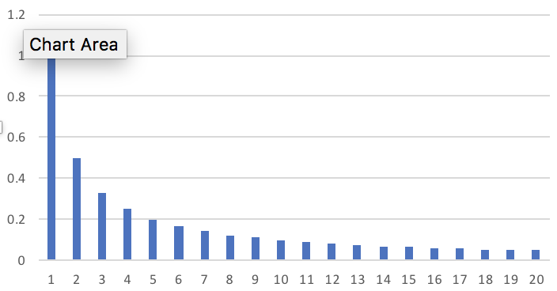
Distribution of variant allele frequencies
Density D_{i}(n) of mutations with derived allele frequency i in a sample of n is θ/i
Proof by induction
True for n=2 by definition of θ
Assume true for n and consider adding (n+1)^{th}
For i > 1 mutation is not in new epoch. Split by whether first coalescence is to a branch with mutation or not.
D_{i}(n+1) = D_{i-1}(n)(i-1)/n + D_{i}(n)(n-i)/n
= θ /n + θ (n-i)/in
= θ (i + n-i)/in = θ/i
For i = 1 add mutations in new epoch on any branch
D₁(n+1) = D₁(n) (n-1)/n + θ (n+1)/(n+1)n
= θ (n-1)/n + θ /n = θ

Slide 12
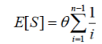
Distribution of variant allele frequencies
Density of derived mutations with frequency i in a sample of n is θ/i
Recall
Population minor allele frequency distribution of a difference observed between two sequences is flat
Probability (1/f).2f(1-f) = 2(1-f), folded at ½ is 2

Slide 13
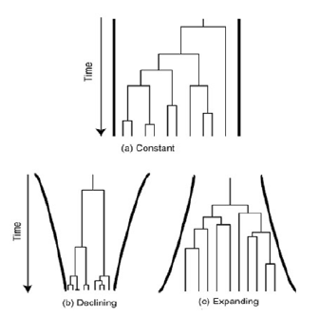
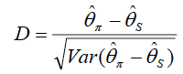
Relaxation of assumptions (1)
E.g. change in population size
Tajima’s D
Sensitive to number of rare mutations, so change in N_{e}
If D is positive there is a deficiency of rare mutations
Excess recent coalescences, recent small N_{e} - selection
D > 0
D < 0

Slide 14
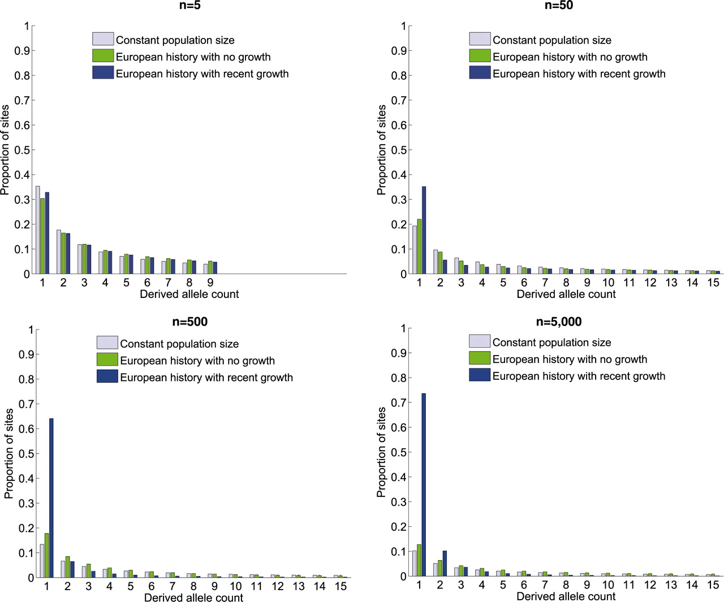

Fig. 2 The expected site frequency spectrum (SFS) of the derived allele (the new mutation arisen in the population) for three different demographic models: (i) a population that has been of constant size throughout history; (ii) a model previously fit to the derived allele frequency spectrum of Europeans, which includes an out-of-Africa population bottleneck and a second, more recent, population bottleneck (21); and (iii) the same two-bottleneck model of European history with the addition of recent exponential growth from a population size of 10,000 at the advent of agriculture to an extant effective population size of 10,000,000, which amounts to 1.7% growth per generation during the last 400 generations.
A Keinan, A G Clark Science 2012;336:740-743
Notes:
The expected site frequency spectrum (SFS) of the derived allele (the new mutation arisen in the population) for three different demographic models: (i) a population that has been of constant size throughout history; (ii) a model previously fit to the derived allele frequency spectrum of Europeans, which includes an out-of-Africa population bottleneck and a second, more recent, population bottleneck (21); and (iii) the same two-bottleneck model of European history with the addition of recent exponential growth from a population size of 10,000 at the advent of agriculture to an extant effective population size of 10,000,000, which amounts to 1.7% growth per generation during the last 400 generations. The results presented are based on sequences of 5, 50, 500, and 5000 diploid individuals. Figures are from 10 million coalescent simulations (32); the expectation of models 1 and 2 were also validated analytically (21). In all panels, the proportions of all possible derived allele counts, ranging from 1 to 2n – 1, sum up to 1, although only those for 1 through 15 are presented. See fig. S1 for a version of this figure in which singletons are excluded and the SFS renormalized.

Slide 15
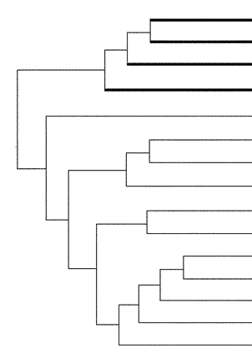
Individuals in outbred populations still carry many variants not in the 1000G, UK10K and other similar data sets
Exponential population growth in last 10,000 years gives long tips to the tree
In “big” populations, tips are hundreds of generations long, so tens of thousands of private variants per sample, hundreds functional

Slide 16
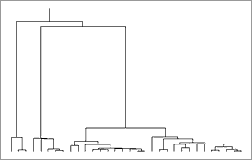
This behaviour is very dependent on population structure. In genetic isolates the recent effective population size is smaller, and the tips are shorter

Slide 17

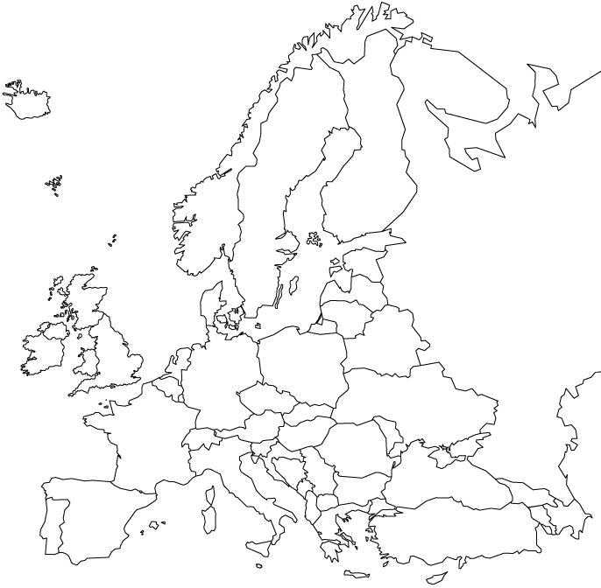
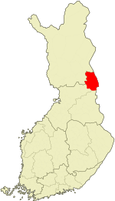
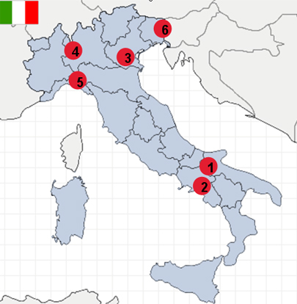
Genetic isolates
Northern Finnish Birth Cohort: ~500k popn
Kuusamo (Finland)
Iceland: ~300k popn
ORCADES (Orkney)
Finland: ~5M popn
Italian Network of Genetic Isolates
1: Carlantino
2: Cilento National Park:
3: Stoccareddo
4: Val Borbera
5:Friuli Venezia Giulia
10,001 Dalmations
Croatian islands
Sardinian isolates
Populations of ~10k
founded hundreds ~1kya

Slide 18
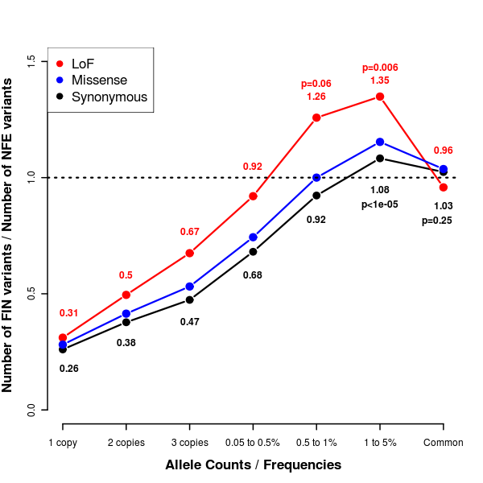
Relative numbers of variants in 3000 Finns v. 3000 Non-Finnish Europeans
Relatively fewer singletons and more mid-frequency variants.
Effect is stronger for deleterious mutations because purifying selection is less effective at keeping deleterious mutation frequency low in small populations.
Lim, E. T. et al. Distribution and medical impact of loss-of-function variants
in the Finnish founder population. PLoS Genet. 10, e1004494 (2014).

Slide 19
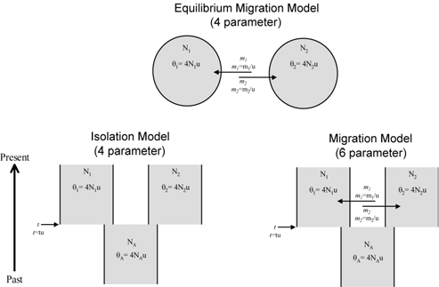
Relaxation of assumptions (2)
Structured populations

Slide 20
Effective population size
Lots of mystique/angst about this
Our definition is arguably at the core of the concept
the reciprocal of the probability of sharing a parent in the previous generation
= 1 / coalescence rate
Why this is different from census population size:
Many consequences occur over large numbers (often order of N_{e} generations) – long term averaging
Structure generates non-random patterns of coalescence, and non-independence between generations
Maybe only a small percentage of individuals breed
Selection favours some individuals over others
But is always something of this form that we get at by population genetic analysis

Slide 21
What about recombination?
If points on the genome are very close, e.g. adjacent, they share the same tree
If points are very far, their trees are sampled from the coalescent independently
What happens in between?
A recombination in the ancestor of a modern sequence made it out of two separate sequences, one contributing to the left and one to the right

Slide 22
Segments of fixed TMRCA are separated by recombination
Past
Recombination in some ancestor
Mutations
Notes:
To answer this question, we first need to understand what this distribution implies. In fact, the human genome is diploid and the two haplotypes always coalesce some time back in the past. Different regions may have different coalescent time, separated by the ancestral recombinations. Regions that coalesce recently has low heterozygosity and regions that coalesce anciently has high heterozygosity. And so there is a direct link between heterozygosity and regional coalescent time.

Slide 23
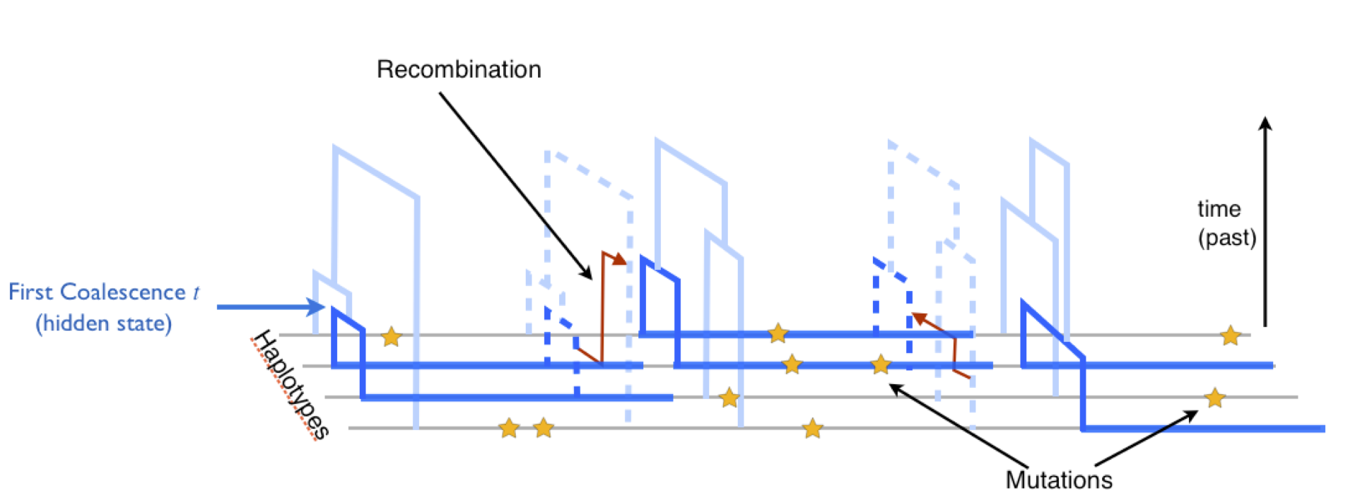
Recombination changes the tree as you move along the sequence
Typically recombination rate is comparable to or larger than the mutation rate: both ~10⁻⁸ /bp /gen in human
So “gene tree” varies every site in mixing populations

Slide 24
Ancestral Recombination Graph (ARG)
The Ancestral Recombination Graph describes the way that individual sequences in a population are related
At a locus, sequences are related by a tree
Ancestral recombinations change the tree as you move along the chromosome
a ..C..G..A..
b ..T..G..C..
c ..T..A..A..
d ..T..A..C..
0 0 0
1 0 1
1 1 0
1 1 1
1
3
2
R
a b c d
a b c d
a b c d
a b c d
ARG
“Prune and graft” operation going left to right

Slide 25
Coalescent with recombination
ARG is a structure (data type)
The probability distribution over ARGs that arises when recombination is added to the standard (Wright-Fisher) model is called the Coalescent with Recombination
Hudson’s ms software implements this
New msprime from Jerome Kelleher MUCH faster
Now two possible events going backwards in time
Coalescence: which merges two sequences
For i sequences, rate is i(i-1)/2N
Recombination: which splits a sequence into two
For i sequences, rate is iLρ

Slide 26
Problems with the full coalescent with recombination
If L > 1/2Nρ then convergence is extremely slow
Whatever the number n of samples, the number of ancestral sequences tends to 2NρL-1
The actual number fluctuates in a random walk around this, and only converges when it hits 1 ^{(*)}
Above recombination events, only part of each parent contributes sequence to the child
As we go back in time through multiple recombinations and coalescences, the fraction of each sequence that contributes to the observed samples becomes smaller and more fragmented…
(*) Actually it is a bit more complicated….

Slide 27
Example
l
m
h
i
j
k
g
e
f
a b c d
l
ARG
m
h
i
j
g
e
f
a
b
c
d
General case:
A general sequence higher up in the graph contains short segments of “live” sequence separated by regions that do not contribute to the final observed sequences a,b,c,d

Slide 28
Sequentially Markovian Coalescent approximation (McVean and Cardin, 2005)
Only consider the coalescences between sequences whose active segments overlap
Others (e.g. i+e -> l in previous slide) are ignored: effectively treat left and right segments as independent
General case now contains only a single live region
Equivalent to left to right “prune and graft” process on trees
This addresses the problems in the previous slide
Supports efficient inference because of left to right Markov property
Very good approximation to the coalescent with recombination
Simulation implemented in MaCS (Chen et al. 2008)
Newer approximation SCRM (Staab et al. 2015) keeps short gaps
Now superseded by msprime (Kelleher et al. 2016) , which does it all properly

Slide 29
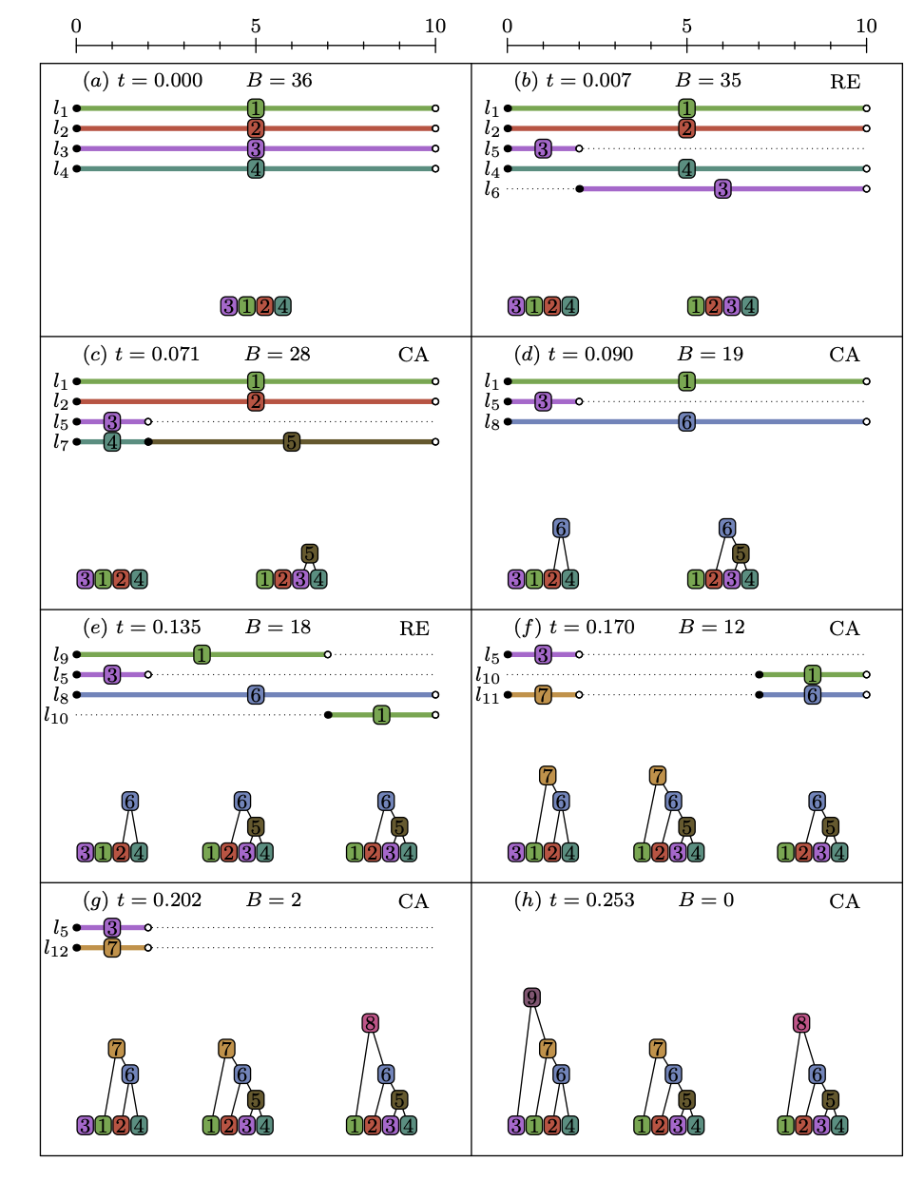
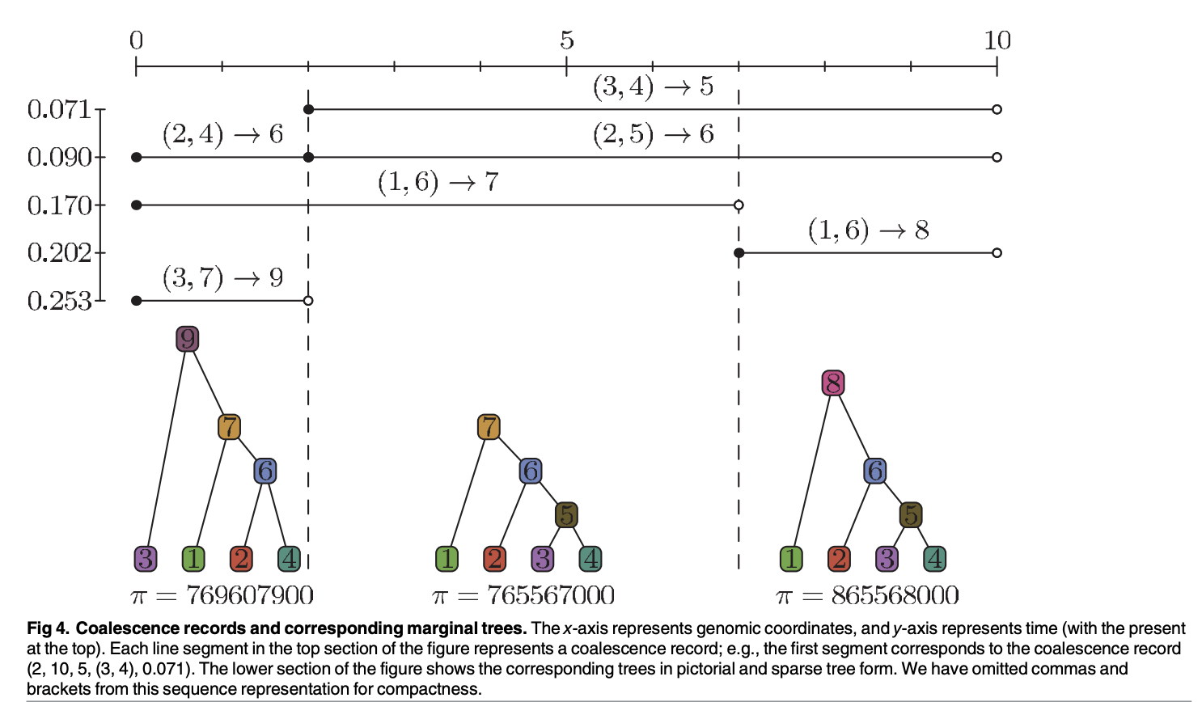
Kelleher’s “Tree sequence” representation
Kelleher, J., Etheridge, A. M. & McVean, G. Efficient Coalescent Simulation and Genealogical Analysis for Large Sample Sizes.
PLoS Comput. Biol. 12, e1004842 (2016).
Hudson’s algorithm

Slide 30
How many effective recombinations do we expect?
Recombinations occur at random on the tree
Recombination rate in humans is around the same as mutation rate
Around 30 per generation per haploid genome
One per 100Mb (a bit more than one per chromosome)

Slide 31
“The divine right of kings”?
We each have 2^{n} ancestors n generations back
(some might be multiple ancestors)
We have ~60n genome fragments from n generations back
~30 recombinations per generation per haploid genome
2^{n} > 60n for n > 9
The chance of having any DNA from a particular ancestor 10 generations back < 50%
It drops rapidly beyond that
Dynasties are rarely longer than 10 generations….
Few ancestral genealogies go back more than 10 generations (~300 years)

Slide 32
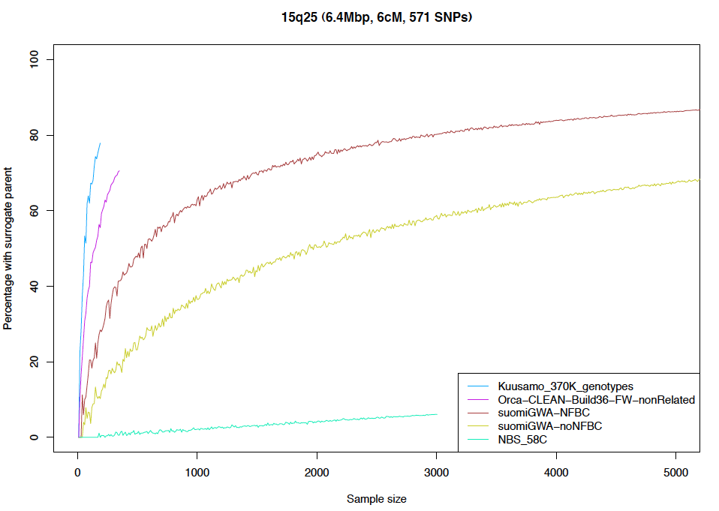
The ability to match long haplotypes depends on population structure
Long range haplotype matches allow very accurate imputation (10⁻⁷ with SLRP)
Kimmo Palin

Slide 33
Inferring demography from genetic data
Population size going back in time
Actually “effective population size” N_{e}(t)
We will come back to what this means
Approximate time range 10k – 1M years ago
Again we will see why
Population structure
Subpopulations and when they split (and merged?)
Based on explicit evolutionary models
Relate patterns of (shared) genetic variation accumulated since a common ancestor to history

Slide 34
Genetic divergence depends on TMRCA and mutation rate
Chance of coalescence per generation is 1/N_{e}
TMRCA is exponentially distributed with mean N_{e}
Expected divergence is 2N_{e}𝜇

Slide 35
Effective population size
Lots of mystique/angst about this
Our definition is arguably at the core of the concept
the reciprocal of the probability of sharing a parent in the previous generation
= 1 / coalescence rate
Why this is different from census population size:
Most consequences occur over many generations (often order of N_{e}) – hundreds of k years - long term averaging
Structure generates non-random patterns of coalescence, and non-independence between generations
Maybe only a small percentage of individuals breed
Selection favours some individuals over others
But it is always something of this form that we get at by population genetic analysis

Slide 36
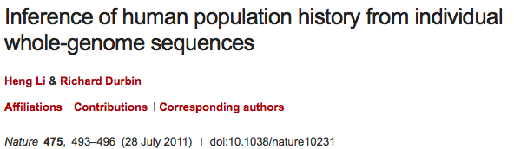
PSMC-HMM
Pairwise Sequentially Markovian Approximation to the Coalescent

Slide 37
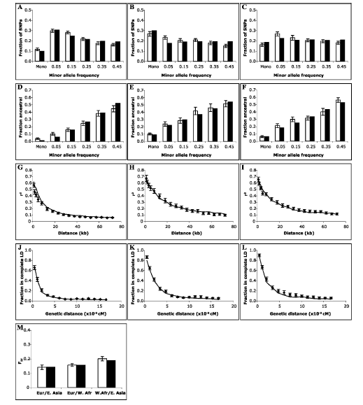
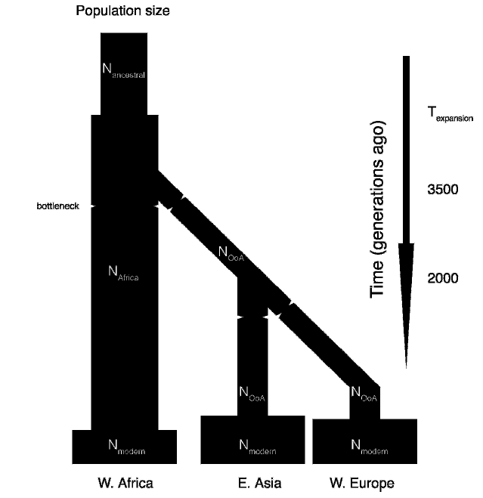
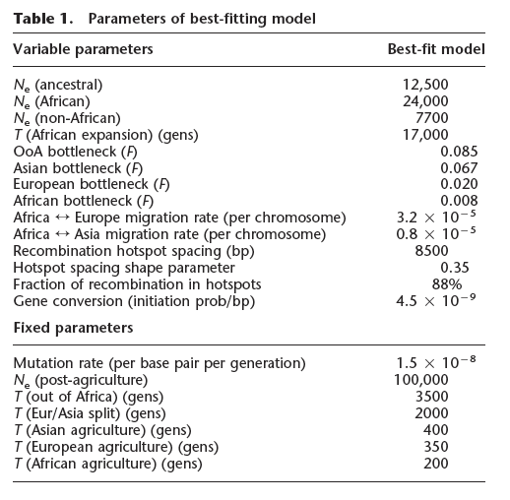
Block model approach to human population size history
Parameters fit from summary statistics on partial data from multiple people
Schaffner et al. “Calibrating a coalescent simulation of human genome sequence
variation”, Genome Research (2005)

Slide 38
Less parametric approach based on the complete (diploid) genome sequence of one person
Past
The distribution of heterozygous positions in an individual reflects the time to the most recent common ancestor
Mutations
Notes:
To answer this question, we first need to understand what this distribution implies. In fact, the human genome is diploid and the two haplotypes always coalesce some time back in the past. Different regions may have different coalescent time, separated by the ancestral recombinations. Regions that coalesce recently has low heterozygosity and regions that coalesce anciently has high heterozygosity. And so there is a direct link between heterozygosity and regional coalescent time.

Slide 39
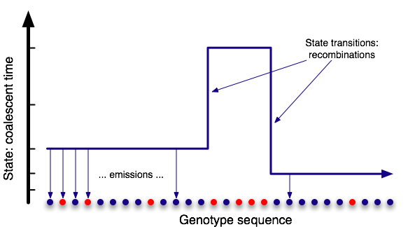
Pairwise Sequentially Markovian Coalescent Li and Durbin (2010): Inference of human population history from individual genome sequences
Hidden Markov Model

Slide 40
PSMC Hidden Markov Model
Move from left to right in the genome
Let P(x|t) = prob(data up to x|TMRCA at x = t)
Calculate P(x+1|t) = (∑_{s} P(x|s) r(t|s)) e(x)
e(x) = “emission at x” = 2𝜇t if a het, else (1-2𝜇t)
r(t|s) = prob(recombination from TMRCA s to t)
= 2𝜌s prob (coalesce back to t)
+ (1- 2𝜌s) if t = s
Depends on
N(t’) t’ < s,t

Slide 41
Markov assumption
This model assumes that
data to the left of x|TMRCA at x = t
is independent of
data to the right of x|TMRCA at x = t
For standard mixing populations this is a very good assumption
Sequentially Markovian Coalescent approximation, McVean & Cardin 2005
We can fit N(t) by Baum-Welch

Slide 42
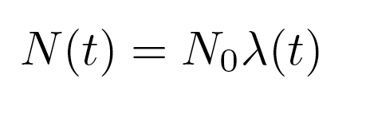
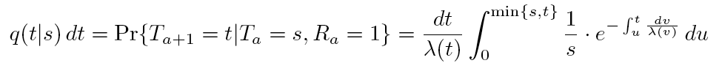
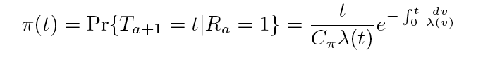
Key equations from coalescent theory
Het probability and recombination probability depend on t: p(het|t) = 2μt, p(rec|t) = 2ρt
Distribution of segment ages depends on population size history
Transition probability, given a recombination
Stationary distribution of segment ages

Slide 43
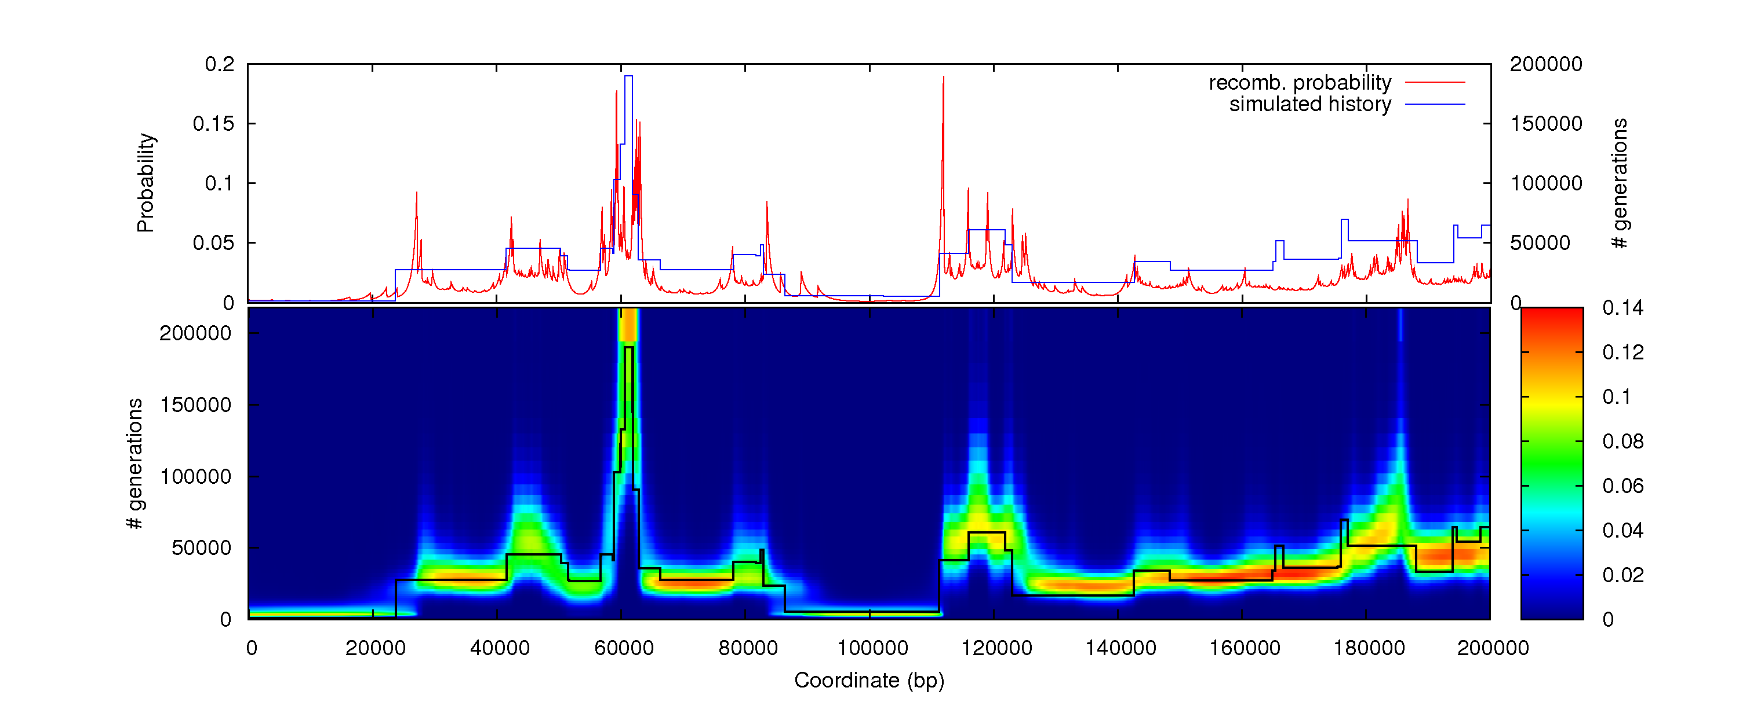
PSMC-HMM reconstructs individual history
Pairwise Sequentially Markovian Coalescent – Hidden Markov Model
Data simulated using ms (Hudson)
Model the coalescent time t by e.g. 50 discrete bins, spread logarithmically

Slide 44
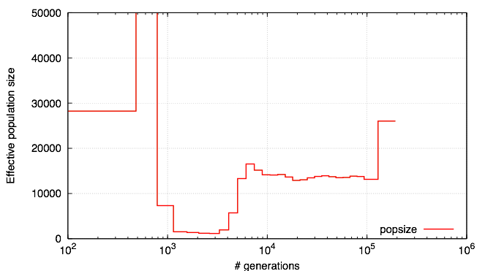
Inferred N(t) gives the history of the population size
Blue is simulated size history, red is fit by PSMC
Notes:
PSMC still performs well when there are sudden changes in the population size. Here the dot blue line shows the parameters used in simulation and the red curve is the estimate from PSMC. (if there is no bottleneck....)

Slide 45
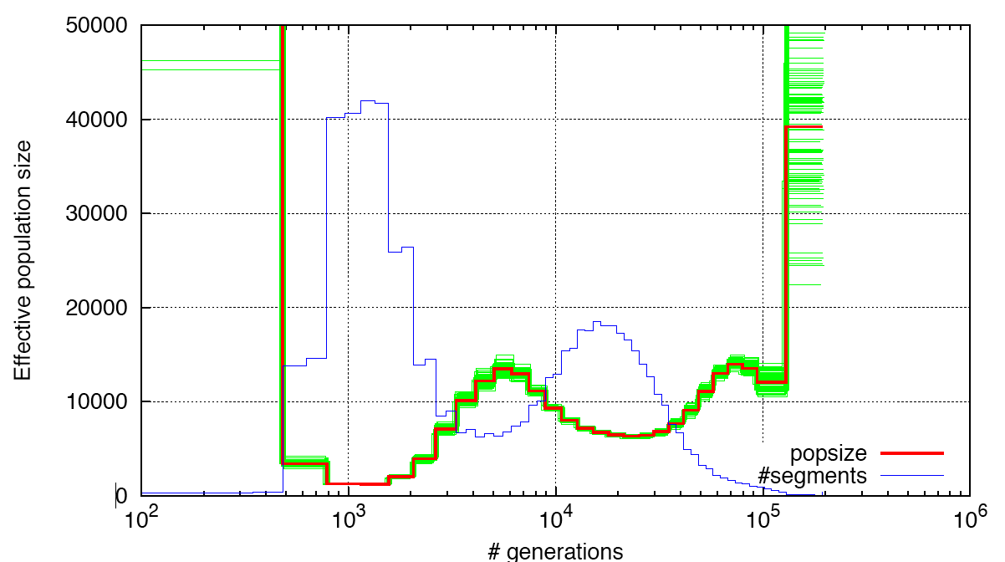
Single human genome with bootstrap

Slide 46
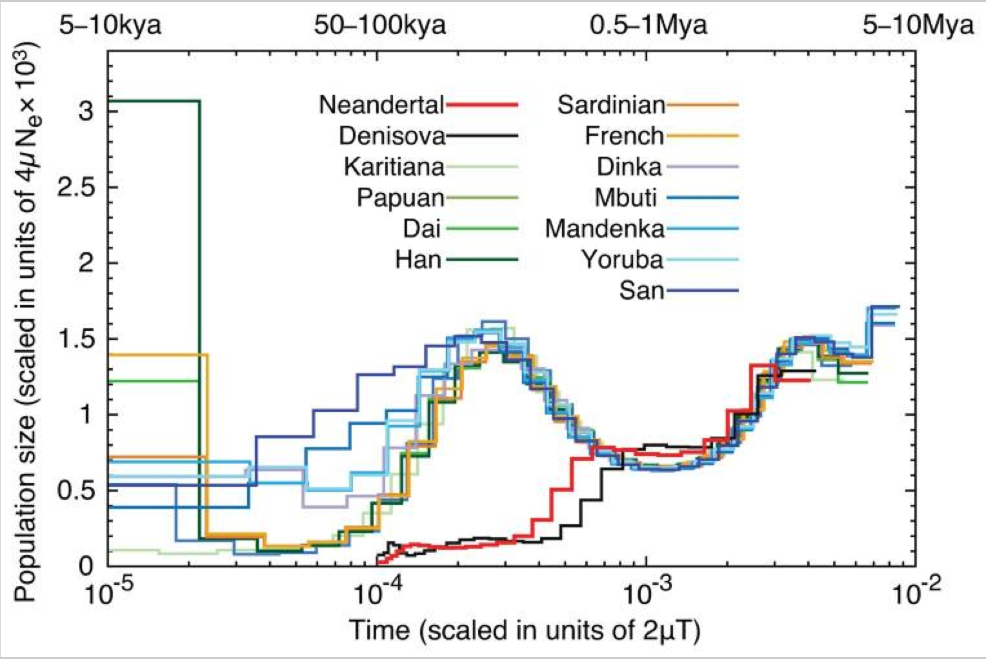
Human population history, with Neanderthals
Scaled coalescent time
Heng Li

Slide 47
Advances since the original PSMC
Use SMC’ model which correctly handles recombinations coalescing back to the same ancestor (Schiffels, …)
Minor tweak to equations, but significant
Can now fit recombination:mutation ratio
Implemented in MSMC/MSMC2
Time speedup: linear not quadratic in number of time slices (Harris, ... Song, 2014)

Slide 48
Problems/issues
Non-panmictic ancestry
Ancestral structure leads to incorrect inference
Mutation rate
Recent direct estimates suggest a substantially lower mutation rate
Accessing more recent time, and more complex structure
Extending to more than two sequences: MSMC

Slide 49
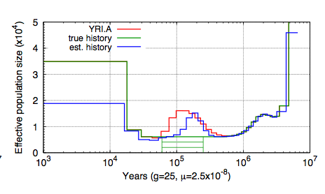
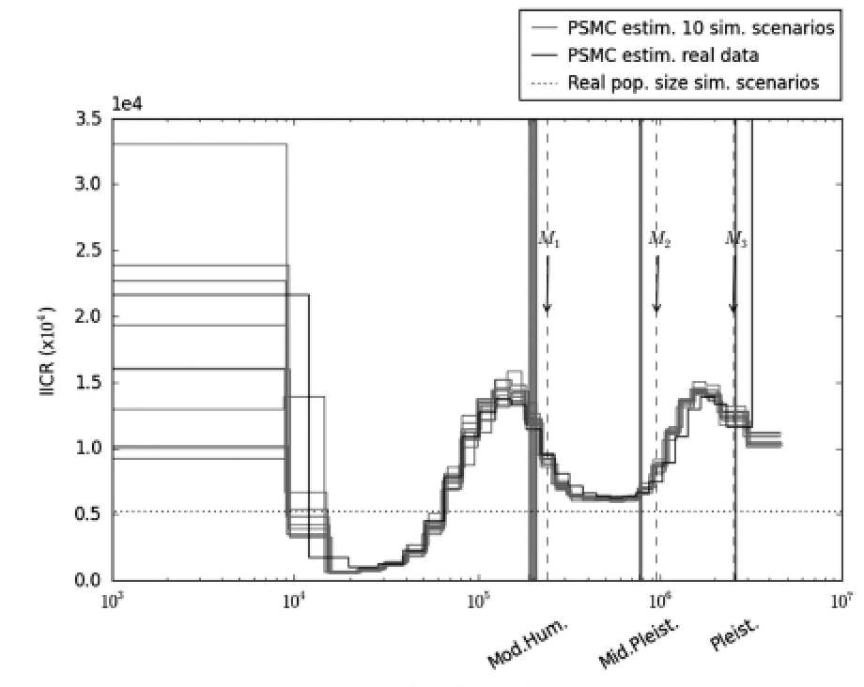
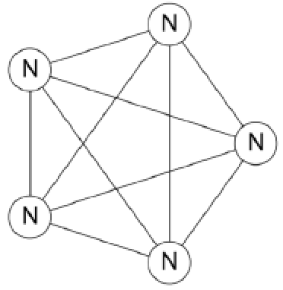
1. Coalesecent N_{e}(t) reflects ancestral structure as well as population size
PSMC actually measures λ = 1/coalescence rate
Structure can also change coalescence rate
Li & Durbin supplement
Olivier Mazet…Chikhi
N-island model
Migration between
islands controls coalescent rate

Slide 50

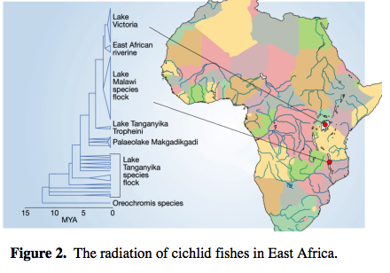
Brief introduction to another system
Dramatic recent radiations of haplochromime cichlids in the African rift valley great lakes
Lake Malawi ~500 species within last 1M years
So far we have sequenced ~80 species at 15-20x coverage

Slide 51
Lake Malawi cichlid PSMC
4x
4x
4x
(Very) approximate

Slide 52
Is structure associated with speciation?
Perhaps
Ideas of hybrid speciation, reuse of alleles selected in different environments, hybrid swarms and gene flow
But this is another talk…

Slide 53
Might structure be (partly) identifiable in the PSMC model?
The inferred values N(t) have dimension T, the number of time bins
But the transition matrix M has dimension T²
Currently we derive M from N by theory assuming panmixia
Is there a richer theory for structured populations?
How to parameterise structural complexity S(t) at time t, with associated theory for M(N,S)
Or can we fit the transition matrix M unconstrained?
Then search for evidence of structure within it
And or do goodness of fit?

Slide 54
2. Mutation rate
Until ~2010 people assumed the human mutation rate was ~2.5x10⁻⁸ per bp per generation
1x10⁻⁹ bp⁻¹ year⁻¹ from macaque divergence
25 years per generation
But direct measurement on whole genome sequences of trios suggests ~1.2 bp⁻¹ gen⁻¹
Still hard to measure and some debate
Depends on male/female, age, …
And human generation mean time is actually 30 years not 25

Slide 55
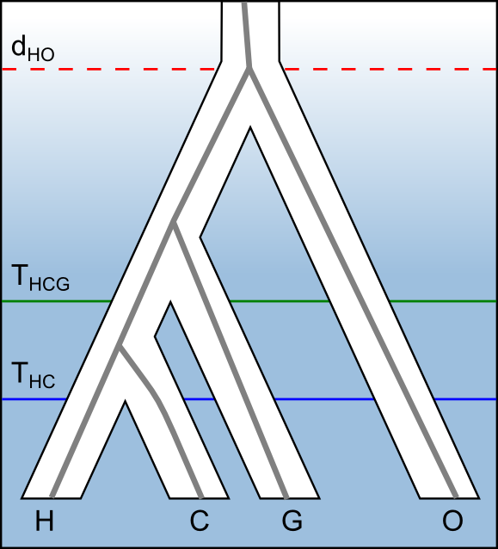
Speciation of the great apes from gorilla genome sequence comparison
Old mutation rate estimate (dashed line) is inconsistent with fossils
New direct mutation rate estimates are consistent

Slide 56
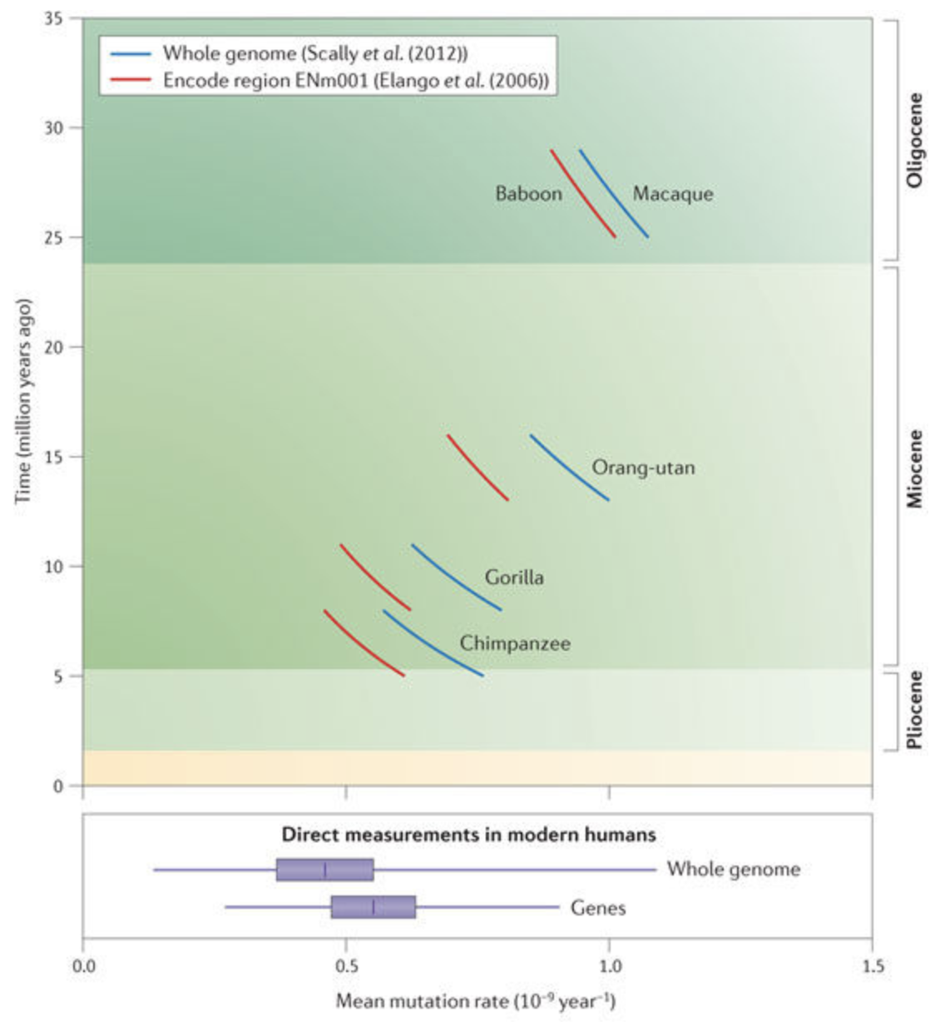
Mutation rate change in great apes
Increase in generation time with larger body size?
Beware branch shortening across species…
Scally and Durbin 2012

Slide 57
Consequences of lower mutation rate
Human mean effective population size is 20,000 not 10,000
Mean coalescence time for human lineages is 1Mya not 500kya
Change to mean “out-of-Africa” estimates towards 100kya
But note that this is separation from Yoruba in West Africa, not all Africans (see later)

Slide 58
End of first lecture

Slide 59
Extending to multiple sequences
The recent time limit of ~20kya for PSMC is set because we run out of recent coalescences between two haplotypes
If we add more haplotypes, then there are more recent coalescences and we could look at more recent history
But, … the hidden state is then a tree (with branch lengths): impractical to model fully
Number of trees ~ n^{n}, e.g. 2.6x10⁹ for n=10

Slide 60
Option 1: First coalescence of one sequence to the tree of the others
t₂
t₄
t₁
t₃
This is related to the Li and Stephens model (or Stephens and Donnelly) – next slide
t₄
t₂
t₁
t₃

Slide 61
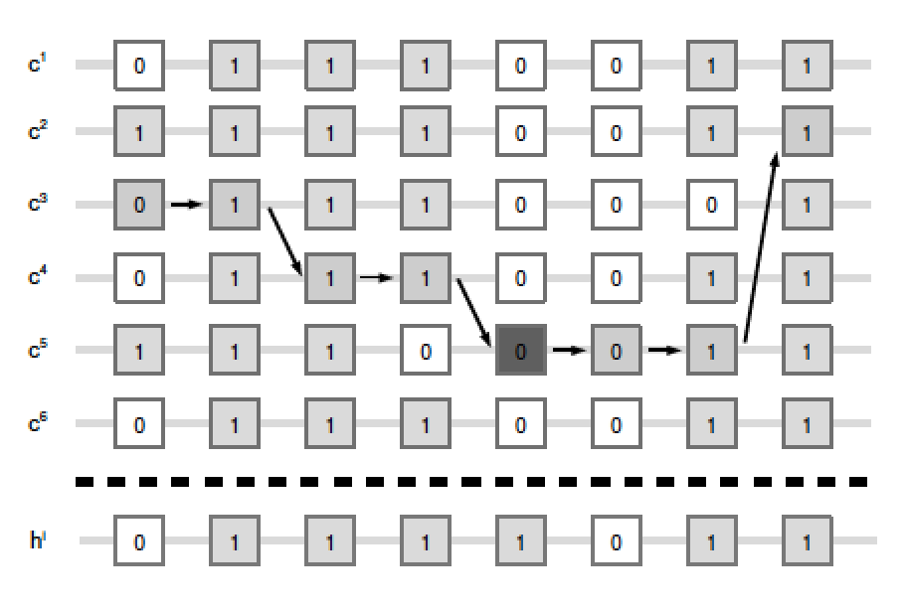
Forward pointer: Li & Stephens model
An important approximation to the coalescent with recombination that adds sequences one-by-one
Add sequences one by one
P(mutation) and P(recombination) both proportional to 1/n
HMM conditional on previous sequences
But no coalescence depending on pop size
Not for demography – we will return to this
Modeling linkage disequilibrium and identifying recombination hotspots using single-nucleotide polymorphism data Li N, Stephens M. Genetics. 165:2213-33 (2003)

Slide 62
Problem: Coalescence of chosen sequence to the others depends on the number of lineages M(t) remaining at time t
t₂
t₄
t₁
t₃
M(t) is a random variable, and we need the entire history of M(t) to calculate transition probabilities q
Huge increase in state space and/or this breaks Markov assumptions
But see DiCal from Yun Song’s group
Sheehan, S.*, Harris, K.*, Song, Y.S. Estimating variable effective population sizes from multiple genomes: A sequentially Markov conditional sampling distribution approach. Genetics, 194 (2013) 647-662.

Slide 63
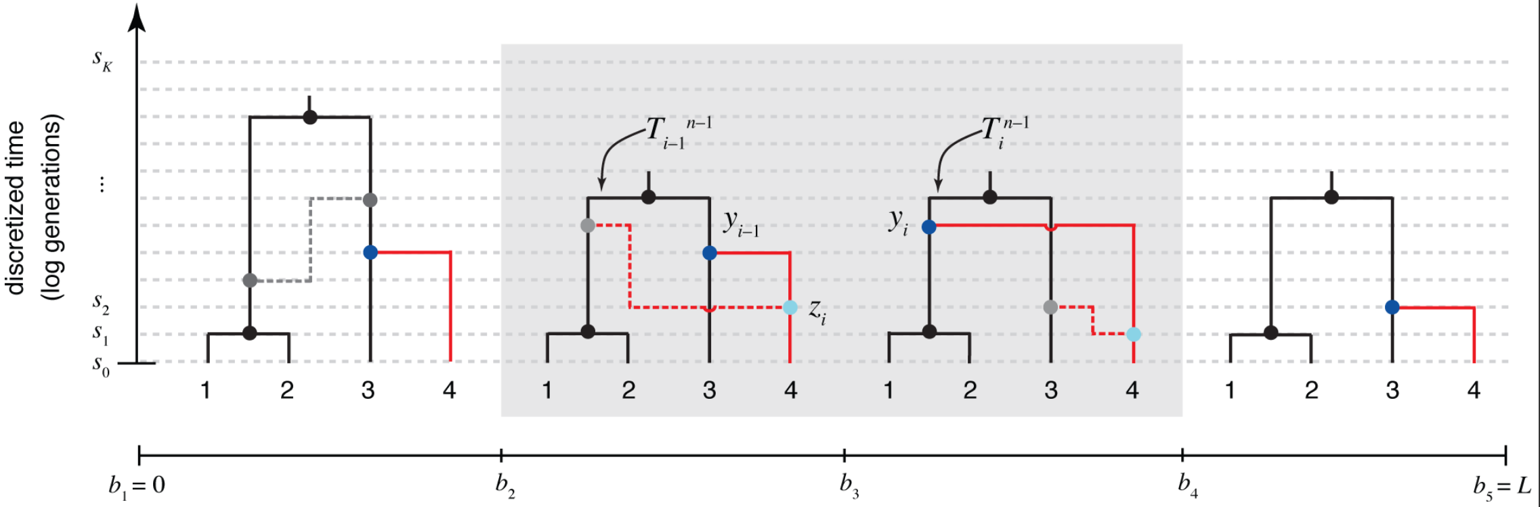
MCMC approach: ARGweaver
Repeatedly remove a sequence* and add it back, sampling conditional on remaining ARG
HMM: sample with forward-backward algorithm
Costly – use for inference given history
Genome-wide inference of ancestral recombination graphs
Rasmussen MD, Hubisz MJ, Gronau I, Siepel A. PLoS Genet. 10:e1004342 (2014)

Slide 64
Option 2: first coalescence between any pair
This remains (approximately) Markov
State space is O(M²T) – pair of states and time they coalesce
But transition updates are only O(M²T²), because transitions are memoryless
Emissions from X_{ij} are singletons on i or j
Non-singletons that are discrepant between i and j wipe out density at X_{ij}

Slide 65
MSMC
Stephan Schiffels and Durbin (Nature Genetics, 2015)

Slide 66
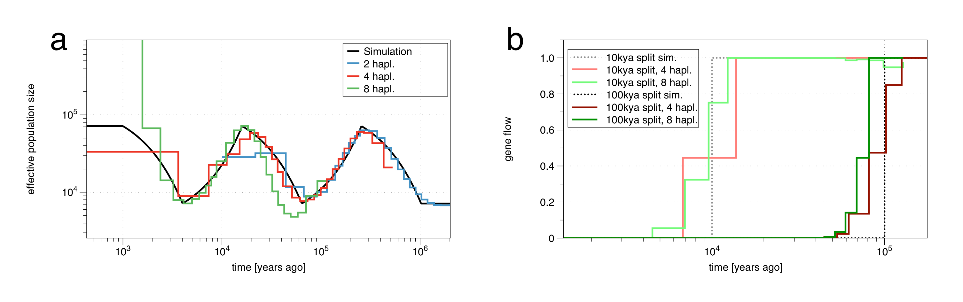
MSMC can fit both population size history and separation history
Separation via the (scaled) ratio of coalescence between and within populations (details two slides later)

Slide 67
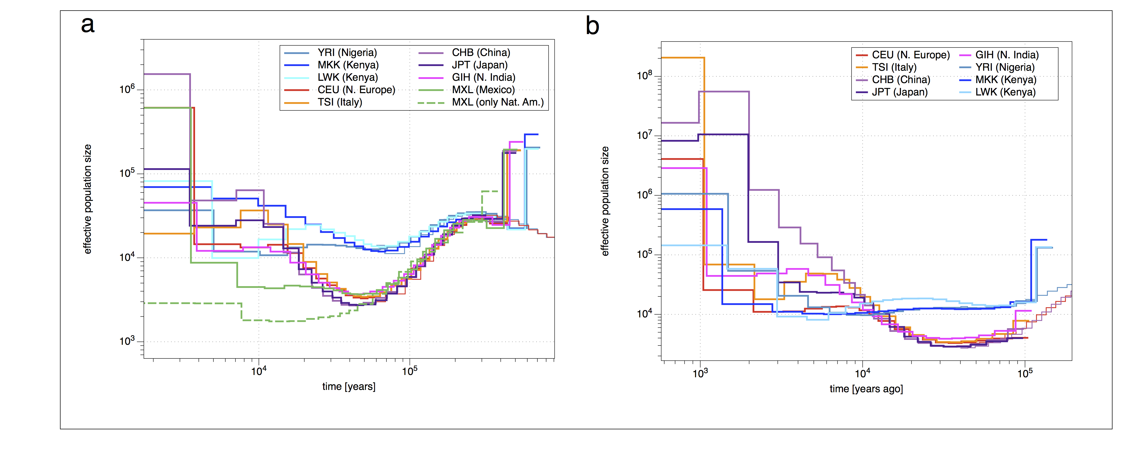
Access more recent history
Use lower mutation rate here ~ 0.5x10⁻⁹/year

Slide 68
Divergence between populations
Idea: Infer separate coalescence rates within and between populations:
First Coalescence within Population 1
First Coalescence within Population 2
First Coalescence across both populations
MSMC can infer separate coalescence rates within and between populations
Given rates within populations, λ11(t) and λ22(t), and across populations, λ12(t), compute relative gene flow as ratio
λ12(t)
m(t) =
[λ11(t)+ λ22(t)] / 2

Slide 69
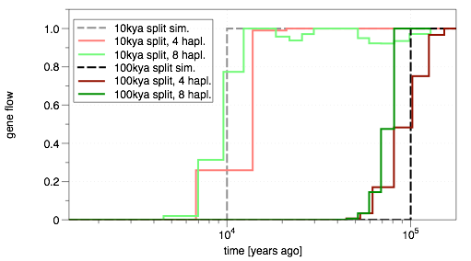
Testing gene flow inference with simulated split
☜ m(t)=1: perfectly mixed
☜ m(t)=0: perfectly split
4 haplotypes: good for splits 50-200kya.
8 haplotypes: good for splits 5-50kya.

Slide 70
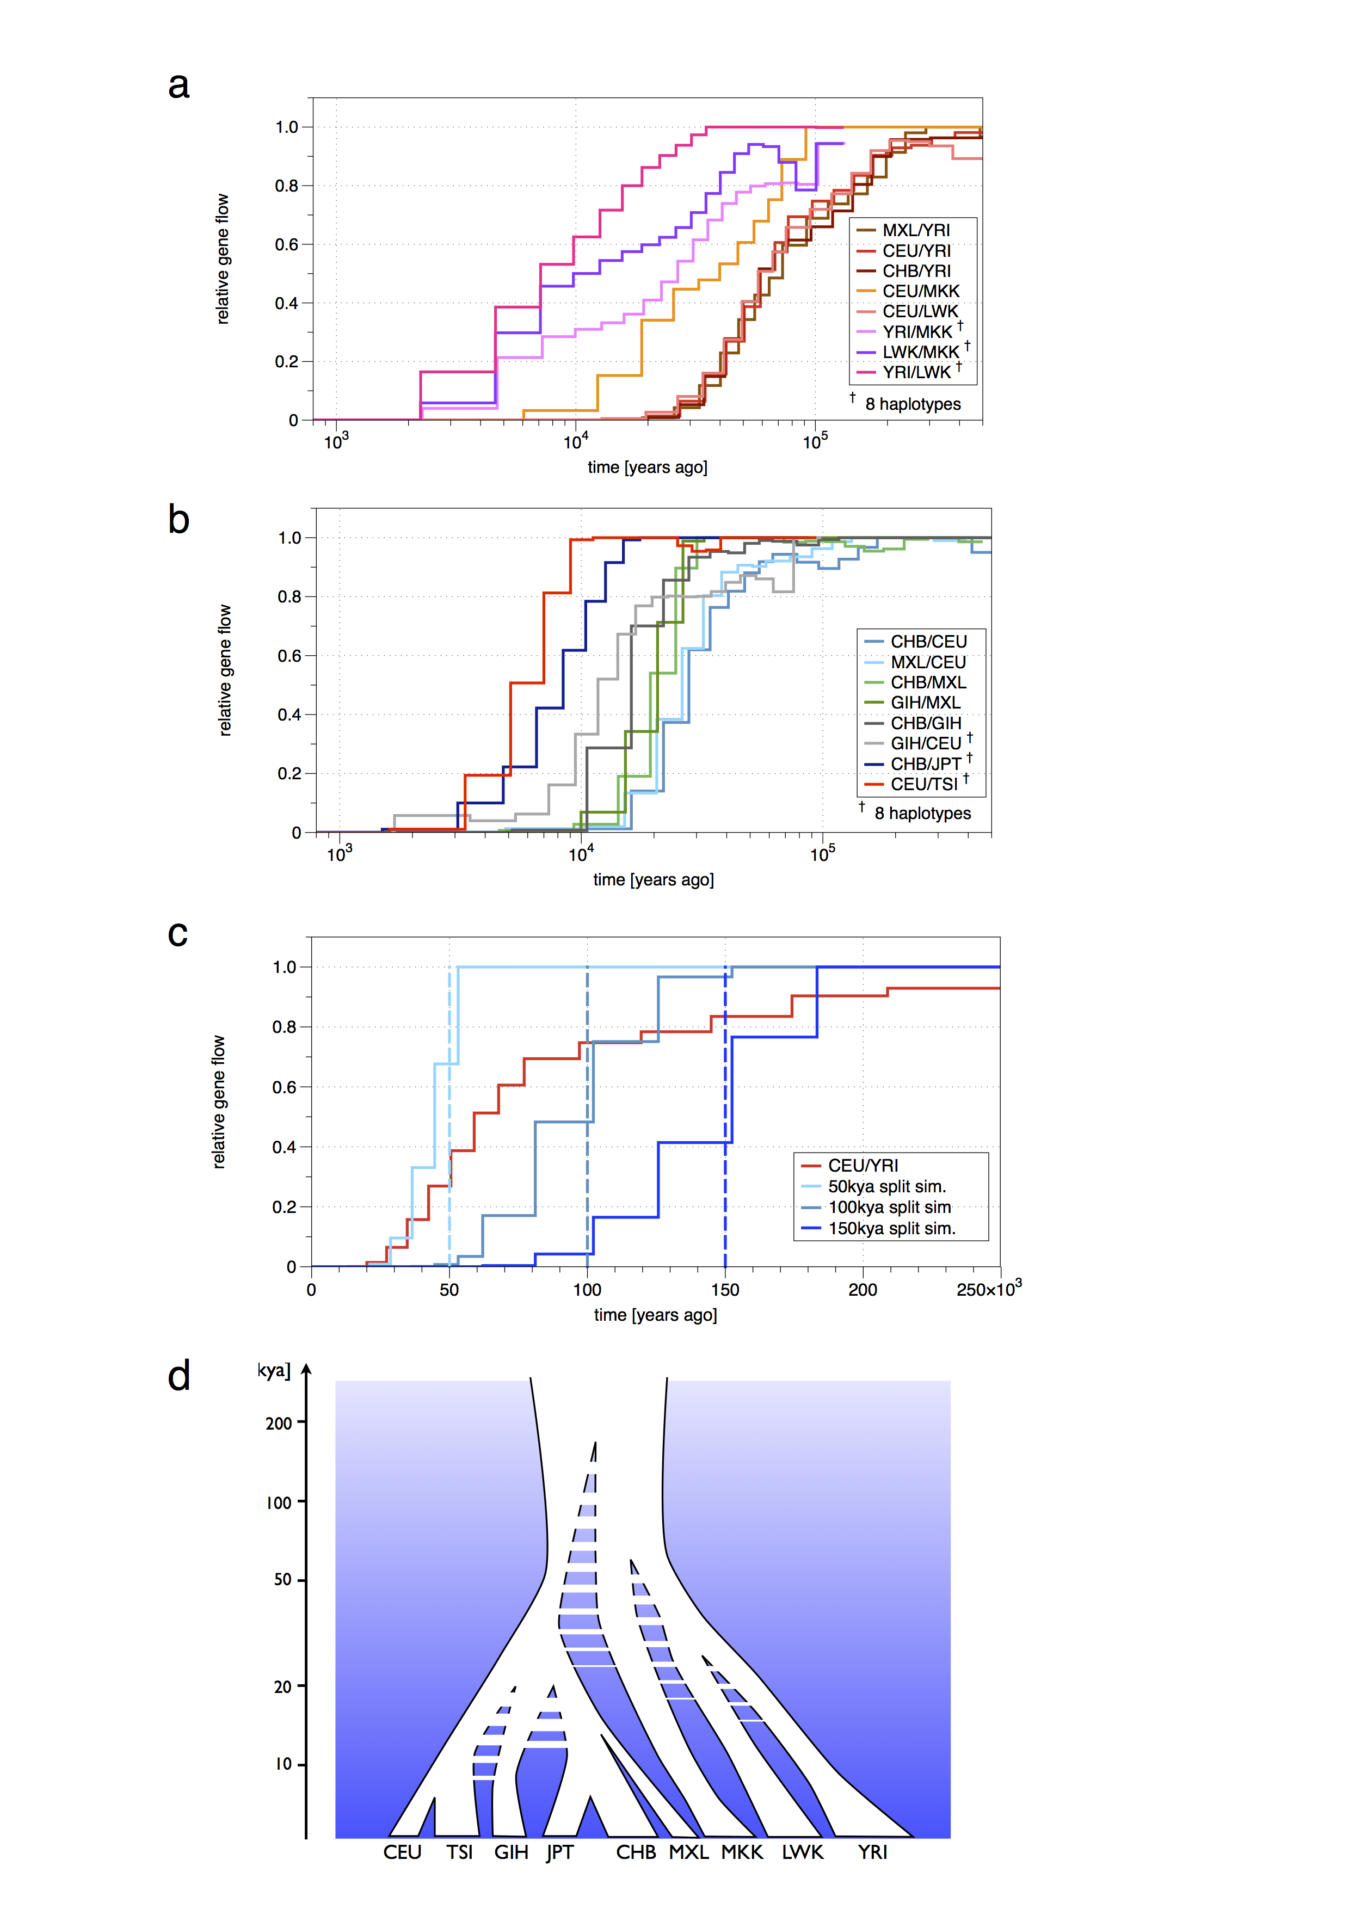
Separation history

Slide 71
An alternative approximation: Ignore recombination and embrace the Sample Frequency Spectrum (SFS)
Previously we talked about D_{i}(n), the density of variants with derived allele frequency i in a sample of n
D_{i}(n) = θ/i for constant population size
Changes with changing demographic history
Can we estimate population size history direct from D()?
No in general
Yes if constrained
No in practice – it is numerically unstable
Myers, S., Fefferman, C., and Patterson, N. 2008. Can one learn history from the allelic spectrum? Theoretical Population Biology, 73:342–348.
Bhaskar, A. and Song, Y. S. 2014. Descartes’ rule of signs and the identifiability of population demographic models from genomic variation data. Annals of Statistics
Rosen, Z., Bhaskar, A., Roch, S. and Song, YS. 2018 Geometry of the sample frequency spectrum and the perils of demographic inference biorxiv doi: https://doi.org/10.1101/233908

Slide 72
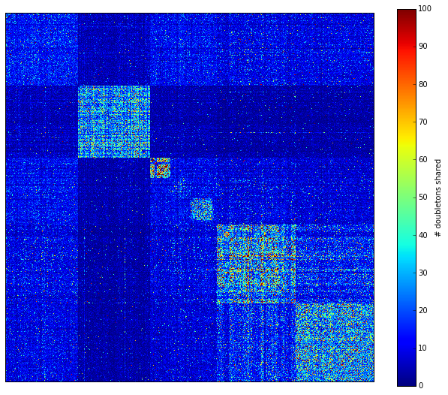
But all is not lost. The Joint SFS contains a lot of information about relationships between populations, particularly in rare variants
CEU
FIN
GBR
IBS
TSI
Rare variants contain information about recent population history and structure
Shown here: number of doubletons shared among European samples
We would like to estimate population split times and population sizes from the frequency of rare variants
[1000 Genomes Project, Phase3]

Slide 73





Ancient samples from Hinxton
12885A, Saxon
12881A, Saxon
12884A, Iron age
12883A, Saxon
12880A, Iron age
Notes:
not only are these samples British, they are as local to the Sanger as it can get.
2,000 years before the Wellcome Trust decided to build one of the world largest sequencing centres,
2 men and 3 women from Roman time Britain were buried under just these grounds
... almost waiting to be found and to be sequenced.
This is what we’re now doing...

Slide 74

More samples from Linton/Oakington

Slide 75

Sharing Patterns between Ancient and modern samples
Difference between Anglo-Saxon and Iron Age sharing with NED and IBS consistent across different Allele Counts
Small but significant differences also within modern Britain (UK10K): Samples from Wales and Scotland share fewer rare variants with Dutch people

Slide 76

Estimates of Anglo-Saxon contribution to modern British genomes
Suggests ~30% Saxon contribution to samples in East of England, and ~20% to UK10K samples from Wales and Scotland
Consistent with 20-40% indirect estimate from POBI (Peoples of the British Isles) study

Slide 77

The rare allele coalescent
Goal: Estimate demographic history (population sizes and split times) from rare variants
Compute likelihood of demographic model given a distribution of rare variants
Stephan Schiffels (Nature Communications, 2016)

Slide 78


RareCoal model
Idea: Define recursion equations for probability of observing i derived alleles in population k:
Given a demographic model, propagate this probability backwards in time to get full likelihood of the data.
Key simplification: Treat number of ancestral alleles over time as average (mean-field approximation):
Stephan Schiffels (Nature Communications, 2016)

Slide 79


Slide 80


Slide 81


Slide 82
Test inference with simulated data
Time (generations)
scaled population sizes
1
0.87
400
388
0.2
0.22
300
299
0.5
0.5
200
200
0.4
0.47
100
92
10
5
2
4
5
10.3
5
2
4
5
Simulated
Estimated
Fits (100 samples per pop.):
Fitting population sizes and split times separates drift from divergence -> different from Treemix
Pattern | Count (real) | Count (predicted)
0,1,0,2,1 | 1114 | 1159
2,1,0,0,0 | 140585 | 139657
1,0,2,0,0 | 1138 | 1205
thousands of rows …

Slide 83

An average European Tree
Used European samples from the 1000 Genomes project (phase 3) plus Danish and Dutch samples
Fitted demographic history to all rare variants up to allele count 4

Slide 84


Placing ancient samples on (a slightly different) tree
Anglo-Saxon sample
Iron Age Sample
Ancient samples can be placed with correctly shortened branches
Ancestral location probably reflects northern continental European ancestry prior to Finland/Denmark/Netherlands separation

Slide 85


Slide 86

Alternative Joint SFS models
Dadi: Gutenkunst et al. PLoS Genetics 2009
Calculate the pairwise SFS under the diffusion approximation
Momi(2): Kamm … Song 2016, 2018 (biorxiv)
Use the Moran model for efficient coalescent calculation
FastSimCoal(2): Excoffier group
MCMC to fit joint SFS using simulations

Slide 87
Return to the Li & Stephens model
Match sequence to a series of segments from a panel of previous sequences
p_{ij} = P(x_{1..i} | x copies from y_{j} at position i)
p_{i+1j} = [ (1-r_{i}) p_{ij} + r_{i} /n Σ_{k} p_{ik} ] P(x_{i+1} = (y_{j})_{i+1})
transition emission
Another Hidden Markov Model

Slide 88


Chromopainter and FineStructure
Build “co-ancestry matrix”
Fraction of time that sample i copies from sample j
First coalescence; more recent history; cf doubletons
FineStructure clusters this
Inference of population structure using dense haplotype data.
Lawson DJ, Hellenthal G, Myers S, Falush D. PLoS Genet. 2012 8:e1002453

Slide 89

Peoples of the British Isles (POBI)
2039 people with four grandparents born within 50 miles of each other
Genotype data
The fine-scale genetic structure of the British population Leslie S et al. Nature 519:309-14 (2015)

Slide 90
Another use for haplotype models: imputation of missing data
a g a g t t g a g g g a a c c t g a g a a
t g a g a c g a g g g a a a t t g a g a c
t g c g a c g g t g a t t c t c c a g a c
a g c g a c g a t g g t a c t t g a t c a
t a a g t t a g t a a t t c c c g a g c a
t g c a a t g a g g g a a a t t g t t a a
a g a g a c g g g g g a a a t t c t g c c
Reference haplotypes via sequencing studies
e.g. 1000 Genomes Project, UK10K
g a g g t a a
g c t a t t c
a t g g t t a
g c g g c a a
g c t g t t c
g c g g c a a
g t g g t a c
a t t a c a a
Genotype data from GWAS
e.g. Type 2 Diabetes, Arthritis, …
(slides borrowed from Jonathan Marchini)

Slide 91
Imputing missing data from reference sequences
a g a g t t g a g g g a a c c t g a g a a
t g a g a c g a g g g a a a t t g a g a c
t g c g a c g g t g a t t c t c c a g a c
a g c g a c g a t g g t a c t t g a t c a
t a a g t t a g t a a t t c c c g a g c a
t g c a a t g a g g g a a a t t g t t a a
a g a g a c g g g g g a a a t t c t g c c
Reference haplotypes via sequencing studies
eg. 1000 Genomes Project
g a g g t a a
g c t a t t c
a t g g t t a
g c g g c a a
g c t g t t c
g c g g c a a
g t g g t a c
a t t a c a a
Imputation of unobserved alleles via matching of shared haplotypes

Slide 92
Imputing missing data from reference sequences
a g a g t t g a g g g a a c c t g a g a a
t g a g a c g a g g g a a a t t g a g a c
t g c g a c g g t g a t t c t c c a g a c
a g c g a c g a t g g t a c t t g a t c a
t a a g t t a g t a a t t c c c g a g c a
t g c a a t g a g g g a a a t t g t t a a
a g a g a c g g g g g a a a t t c t g c c
Reference haplotypes via sequencing studies
eg. 1000 Genomes Project
a g a g t a g a g g g t a c t t g a t c a
t g c g a c g g t g a t t c t t c t g c c
t a a a a t g a g g g a a a t t g t t a a
t g a g a c g a g g g a a c c c g a g c a
a g c g a c g a t g g t a a t t c t g c c
a g a g a c g a g g g a a c c t g a g a a
t g c a a t g a g g g a a a t t g a g a c
t a a g t t a g t a a t t c c t g a t c a
Imputation of unobserved alleles via matching of shared haplotypes

Slide 93
Imputing missing data from reference sequences
a g a g t t g a g g g a a c c t g a g a a
t g a g a c g a g g g a a a t t g a g a c
t g c g a c g g t g a t t c t c c a g a c
a g c g a c g a t g g t a c t t g a t c a
t a a g t t a g t a a t t c c c g a g c a
t g c a a t g a g g g a a a t t g t t a a
a g a g a c g g g g g a a a t t c t g c c
Reference haplotypes via sequencing studies
eg. 1000 Genomes Project
a g a g t a g a g g g t a c t t g a t c a
t g c g a c g g t g a t t c t t c t g c c
t a a a a t g a g g g a a a t t g t t a a
t g a g a c g a g g g a a c c c g a g c a
a g c g a c g a t g g t a a t t c t g c c
a g a g a c g a g g g a a c c t g a g a a
t g c a a t g a g g g a a a t t g a g a c
t a a g t t a g t a a t t c c t g a t c a
Li and Stephens Hidden Markov Model: “select and copy”,
e.g. IMPUTE, MACH
O(NM) methods.
Hard to scale to millions of samples
Imputation of unobserved alleles via matching of shared haplotypes

Slide 94

Uses of Imputation
Inferring sequence from genotype data
Meta-analysis and rare variants
Error-correction
Completion of low coverage/exome sequence data
Statistical phasing
Black: data
Grey: imputed

Slide 95



Haplotype Reference Consortium
Building
Combine calls from 15 data sets
Filter sites and recall at Allele Count >5 (10⁻⁴ allele freq)
Extract genotype likelihoods from BAMs at Sanger, Michigan and rephase in Oxford with GLphase (accelerated HapTest) and SHAPEIT2
COHORT | Samples | Coverage
1000 Genomes | 2500 | 6x
UK10K | 4000 | 6.5x
GoT2D | 2800 | 4x
Sardinia | 6000 | 4x
GoNL | 750 | 12x
Finns | 2000 | 4x
AMD | 3000 | 4x
HUNT | 1000 | 4x
MTFS | 1000 | 10x
ORCADES | 400 | 4x
Italian Isolates | 550 | >4x
HELIC | 2000 | >1x
Bipolar | 4000 | >6x
Crohn's disease | 3000 | 4x
Ulcerative colitis | 2000 | 2x
TOTAL | ~35000
>10M genomes
Winni Kretzschmar, Shane McCarthy, Sayantan Das, Goncalo Abecasis, Jonathan Marchini

Slide 96
HRC imputation performance

Slide 97
Summary
The coalescent (with recombination) provides a different mathematical modelling framework for stochastic genetic variation to the diffusion theory approach
Sampling versus distribution
Population history leaves an imprint in the pattern of variation
Coalescent-based methods can help interpret this pattern and draw inferences from it

Slide 98
Exercise
What can we say about the time to the most recent common ancestor from which any pair of the MPhil students from the class of 2016-17 share inherited DNA?
What theory would you use to estimate this time, and what parameters are required? Suggest some values for these parameters.
What additional factors might modify this estimate? How they would affect it, and by how much?
Can you come up with an estimate and range?
Coalescent theory, (history of) N_{e}, generation time, recombination rate, population structure

